Slide 1

STOCKRIGHT
Stock Right is a Web Application that allows users to get latest stock prices, market news, and other relevant company information. Users can also create an account which gives them access to portfolio where they can add stocks to monitor.

Slide 2
outline
GROUP MEMBERS
PRODUCT NEED
USER REQUIREMENTS
TECHNOLOGIES USED
DEPENDENCIES
FEATURES OF THE WEB-APPLICATION
UI FEATURES
CHALLENGES
TIME SCHEDULE

Slide 3
GROUP MEMBERS
Akshar Gajjar
NSID - ang399
Student Number -11214253
---------------------------------------------------------------------------------------------------------------------
Rohan Patel
NSID – rsp502
Student Number -11247205

Slide 4
Product need
Investing in stocks is one of the greatest ways to create wealth over time. However, for you to be a great investor, you need to have access to accurate and high-quality information and global news feeds.
Modern investors have a wealth of information at their fingertips. Some might say they have too much. All the investing-related noise present on other websites can sometimes be too overwhelming for beginner and small-scale investors and in most cases is unnecessary.
That’s why we designed a simplified UI with the essential information you need to successfully manage a portfolio. Our website provides an easy to use portfolio system for you to keep track what’s important.

Slide 5
User requirements
Show stock quotes
Show company description
Show additional company information such as financials, income statement, No. of employees, etc.
Provide ticker based and company-name based search functionality
Display a market summary in terms of indexes, commodities, and foreign exchange rates
Display real-time trending news articles from reputable sources
Provide Portfolio management functionality. Portfolio must compute total value and total return based on buy price and current price.
Login/register functionality.
Provide definitions for technical terms.
Built-in notification system to inform user of changes.

Slide 6
Technologies Used
APIs
Languages
Additional tools
1) IEX Cloud
https://iexcloud.io/docs/api/
2) Stock News API
(https://stocknewsapi.com/)
3) Yahoo finance
(https://ca.finance.yahoo.com/)
1) HTML, CSS
2) JavaScript
3) Jquery
4) Python
5) Django
6) AngularJS Expressions
1) Visual Studio Code
2) WebStorm
3) Postman
4) Brave (browser)
5) Google Chrome Browser
6) GitHub

Slide 7
Dependencies
ajax==3.0.0
appdirs==1.4.3
asgiref==3.2.3
astroid==2.3.3
beautifulsoup4==4.8.2
certifi==2019.11.28
chardet==3.0.4
click==6.7
colorama==0.4.3
crypto==1.4.1
decorator==4.4.2
distlib==0.3.0
Django==3.0.4
django-appconf==1.0.3
django-crispy-forms==1.9.0
django-widget-tweaks==1.4.8
djangorestframework==3.8.2
djangorestframework-simplejwt==3.2.3
filelock==3.0.12
Flask==0.12.2
Flask-SocketIO==4.2.1
idna==2.8
isort==4.3.21
itsdangerous==0.24
Jinja2==2.10
lazy-object-proxy==1.4.3
lxml==4.4.2
MarkupSafe==1.0
mccabe==0.6.1
Naked==0.1.31
pbr==4.0.2
PyJWT==1.6.1
pylint==2.4.4
pylint-django==2.0.14
pylint-plugin-utils==0.6
python-engineio==3.11.2
python-socketio==4.4.0
pytz==2018.4
PyYAML==5.3
requests==2.22.0
shellescape==3.8.1
simplejson==3.17.0
six==1.14.0
soupsieve==1.9.5
sqlparse==0.3.1
stevedore==1.28.0
urllib3==1.25.7
virtualenv==15.2.0
virtualenv-clone==0.3.0
virtualenvwrapper==4.8.2
Werkzeug==0.14.1
wrapt==1.11.2

Slide 8

FEATURES OF THE WEB-APPLICATION
Browsing Trending, Live News
Getting current stock quotes
In-depth company financials such as valuation, price history, dividends, balance sheets, etc.
Live data for major Indexes and Commodities
Live data for major Foreign Exchanges
Stocks Summary including US and Canadian Stocks
Ability to search ticker or company name to know their details like Stock prices, Company description, Price history Balance sheets. Ticker and company name input validation is based on the api response which is used to display error message to user.
Login/register functionality. Welcome email is sent when a new user registers. Login/Registration uses Django forms which provides input validation as a built-in feature.
Add/remove stocks to portfolio

Slide 9
UI Features
Homepage allows you to collapse certain types of data to help the user declutter the workspace.
Search bar on homepage provides an easy to use dropdown which allows user to search ticker or company name.
A consistent colour scheme is applied throughout the site to normalize the user experience between pages
The login and register pages provides helpful messages in case of incorrect information.

Slide 10
challenges
Implementing a dynamic search bar which changes based on search type selected was something that took longer than expected to implement. We ended using JavaScript to hide and show input fields based on user selections.
Sometimes it’s the small UI elements that make the biggest impact. Adjusting the UI which is attractive and easy to build
Making sure the web application is responsive and works with variety of browsers and devices. Using Bootstrap really helped with making the website responsive with little overhead.
Successfully connecting to the API’s and ensuring the responses are parsed appropriately. We used Postman to verify and understand API responses so we can parse appropriately.
A lot of the data we wished to display was considered premium data by most APIs. The cost for these was significantly high. We had resort to using widgets to get around this issue since our web scraping attempts were unsuccessful.

Slide 11
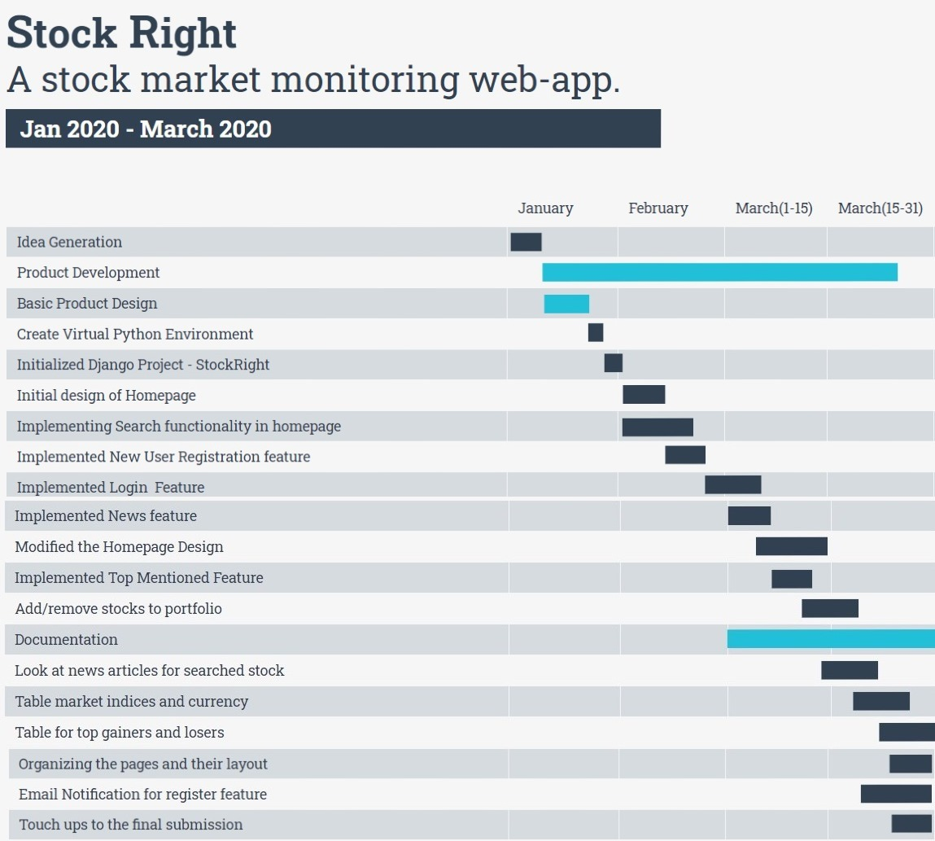
Time schedule

Slide 12
Contact Us
Akshar Gajjar
11214253
Rohan patel
11247205
Email ang399@usask.ca
Email rsp502@usask.ca

